Slide 1
Woodley CofE
New Curriculum 2014

Slide 2
The Journey so far…
The Beginning
Mr Blakely began with ‘creating a world class curriculum’ training in London 2 years ago.
Speakers talked about not ‘throwing the baby out with the bath water.’
The new national curriculum is quite ‘dry’ and has not been without controversy but the staff of CofE have seen it an opportunity to enhance what is there with own ideas and expertise!
Investigating and Exploring
Chris Quigley – Milestones approach was discovered.
We wanted more than just a curriculum that meets the statutory requirements. Foundation subjects are very poorly represented in the new curriculum.
We set about thinking about all the other things that make our school special and that we want to enhance, but also the things that are causing our school to suffer at times. We developed these into the schools ‘curriculum drivers’ (things that make our school unique)
The Staff INSET day 1
Reviewed existing curriculum
Investigating pupil needs
Defining schools New Curriculum Drivers
Introducing and educating teachers about new government curriculum
Chris Quigley Milestones & how they exceed the expectation of new curriculum
Teachers began to plan in teams

Slide 3
The Journey so far…
In-between In-service 1 & 2
Visit to Westcott infants ‘anything is possible’
Staff training sessions on Blooms taxonomy, Learning Objectives and Success Criteria
Staff INSET Day 2
Key/Basic skills children must know (teachers call these Non-Negotiables)
Pupil Attitudes to Learning – BRIGHT (Action research with Westcott infants.)
Defining the Curriculum Drivers.
More time spent planning
Staff INSET Day 3 (morning only)
Planning finished in teams
Overview of topics created, pupil journey through school mapped.
Discussion about predetermined spelling lists.

Slide 4
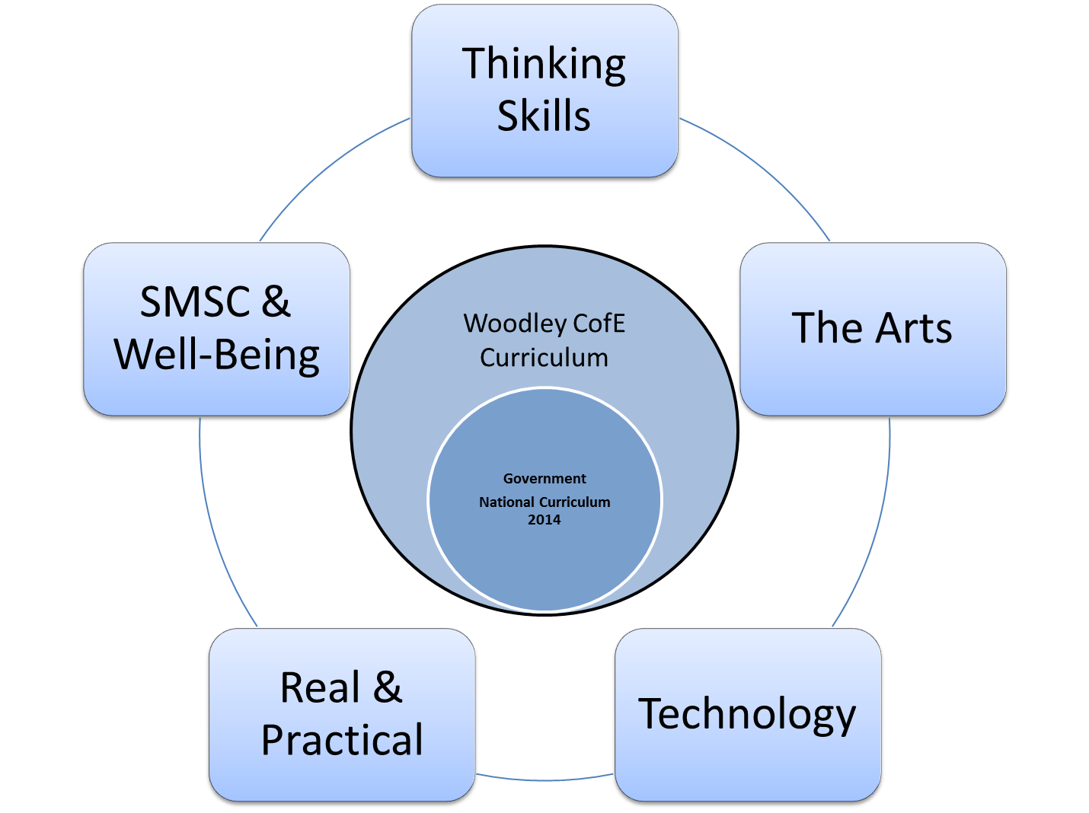
The Curriculum Drivers

Slide 5
The Drivers Explained
Our drivers are areas that we value as a school; they give focus to learning opportunities and are embedded throughout teaching and learning, developing the child as a whole.

Slide 6
Thinking Skills
At Woodley CofE we believe that higher order thinking skills are fundamental to success with learning but also for success in later life. We believe that pupil led enquiry is key to developing these skills.
Through a range of engaging stimuli pupils are encouraged to investigate lines of enquiry through their own questioning.

Slide 7
SMSC & Well-Being
At Woodley CofE we believe that children learn best when they feel secure, valued and confident to talk about their beliefs and feelings. All members of the school community are equally respected.

Slide 8
The Arts
At Woodley CofE we believe that the Arts are vital in developing confidence, creativity and individuality.

Slide 9
Technology
At Woodley CofE we believe that children should develop the skills to innovatively use technology at home and at school for both social and learning purposes. They should have a keen awareness of they use technology to ensure their own safety, health and well-being.
We recognise that technology is a part of our children's natural environment and embrace a wide range of technology as an essential tool for learning.

Slide 10
Real & Practical
At Woodley CofE we believe that quality learning is best facilitated through relevant and meaningful hands-on experiences. We are aware that children have different learning styles and we endeavor to make the curriculum accessible for all.

Slide 11
Basic\Key Skills (Non-Negotiables)
These year specific leaflets are available from the school office.

Slide 12
BRIGHT Learners
Please see Mrs Simmonds’ Brave Learning powerpoint and video

Slide 13
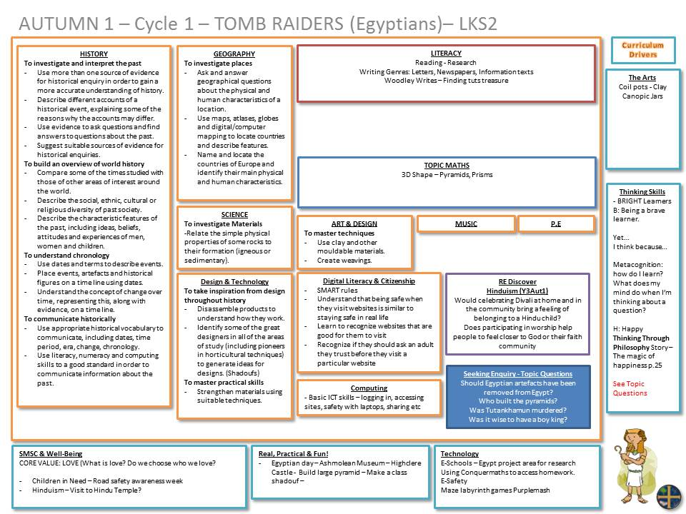
How the planning is coming together!

