Slide 1
Welcome Little Canada presentation

Slide 2
Little Canada Isle of Wight
Monday October 12th –
Thursday October 15th 2020

Slide 3
The Journey Overview
Early departure to travel to Portsmouth Historic Dockyard
Portsmouth Action Stations
HMS Victory
Lunch
Ferry to Isle of Wight (45 mins)
Little Canada
Notes:
We leave at approximately 7.45am to enable us to have a comfort stop on the way. Our staffing ration is a minimum of 1 to 10 children on the journey but we also have a ‘spare’ – a member of staff drives down so that we have a car on site in the event of an emergency.

Slide 4
Portsmouth Historic Dockyard

Slide 5
Action Stations
Participating in a selection of physical and mental challenges, pupils work in teams to develop communication, leadership and negotiation skills.
Possible activities include piloting a Merlin helicopter, climbing a state of the art rotating climbing wall, paddling a canoe behind enemy lines, computer-based recognition, targeting and observation games.
Notes:
At the dockyard we go to a large building which houses Action Stations – a self contained area where the children can take part in a variety of activities including a flight simulator.

Slide 6
Action Stations
Notes:
Challeges are both physical and mental

Slide 7
Action Stations
Notes:
At the end of our time in Action Stations we have lunch. The children need to bring a disposable packed lunch.

Slide 8
Action Stations
Notes:
At the end of our time in Action Stations we have lunch. The children need to bring a disposable packed lunch.

Slide 9
HMS Victory
Notes:
There is a static as well as a rotationg climbing wall

Slide 10
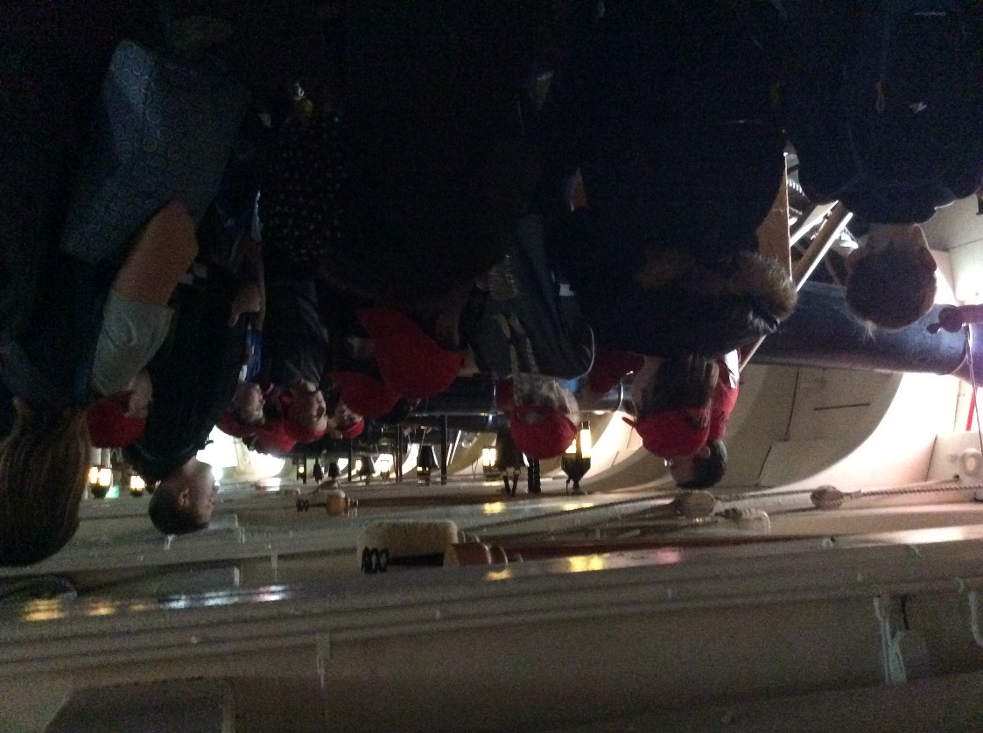
HMS Victory
Notes:
There is a static as well as a rotationg climbing wall

Slide 11
The Journey
The coach drives on to the Ferry
The children are taken up to one of the lounges
No one is allowed on deck without close supervision
Notes:
We don’t ask the children to wear school uniform
If your child suffers from sea sickness please let us know so we can be prepared.

Slide 12
Little Canada

Slide 13
Woodland Site

Slide 14
Wooton Creek
Notes:
The children are not allowed near the water which is well fenced off.

Slide 15
The Creek

Slide 16
Little Canada – Our Chalets

Slide 17
4 – 8 sharing en-suite facilities

Slide 18
Dining

Slide 19
A Typical Day
07.00 - wake up
08.00- Breakfast (English or Continental, cereal, toast and drinks) 09.00- First activity
10.30 - Break 10.45 - Second activity
12.15 - Hot lunch
13.45 - Third activity 15.15 - Break 15.30 - Fourth activity
17.00 - free time 17.30 - 19.00 - 2 course evening meal 19.00 - 20.30 - Evening entertainment.
Group Leaders assist Party Leaders until 21.00.
Through the night there will always be a senior PGL staff member on call.

Slide 20
Possible Activities
Abseiling
Aeroball
Archery
Ball Sports
Climbing
Fencing
Giant Swing
High Ropes
Jacob's Ladder
Challenge course
Survivor
Low Ropes
Quad Biking
Nature Trail
Sensory Trail
Orienteering
Parachute Games
The Matrix
Trampoline
Tunnel Trail
Zip Wire

Slide 21
The Activities
Quad Biking

Slide 22
Zipwire

Slide 23
Challenge course

Slide 24
Climbing

Slide 25
Archery

Slide 26
Abseiling

Slide 27
AEROball

Slide 28
Sensory Trail

Slide 29
Sensory Trail

Slide 30
Chalets

Slide 31
So what happens next….?
If you would like your child to take part in the 2020 Residential Visit you will need to;
Pay a deposit of £40.00 to secure your place by January 31st 2020.
Pay the full amount (£330-£350) amount to be confirmed.
This can be paid in instalments and details of the dates and the payment card will be sent home once your deposit has been received..

Slide 32
Any Questions?

